Slide 1
Hands On Machine Learning
Chapter 14. Computer Vision using CNN
장준영
jjy1019@inha.edu
2024.11.14

Slide 2
INDEX
14.1 Visual Cortex Structure
14.2 Convolutional Layer
14.3 Pooling Layer
14.4 Pooling Layer Implementation with Keras
14.5 CNN Structure
14.6 ResNet-34 CNN Implementation with Keras

Slide 3
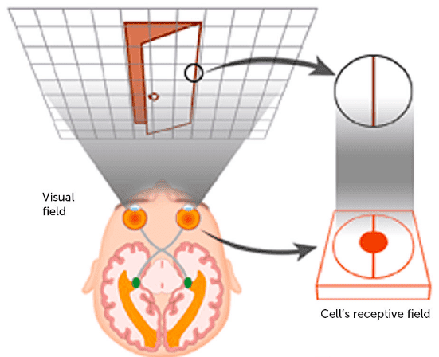
14.1 Visual Cortex Structure
Local Receptive Field
Main idea : Neurons respond only to visual stimuli with a small range of visual field

Slide 4
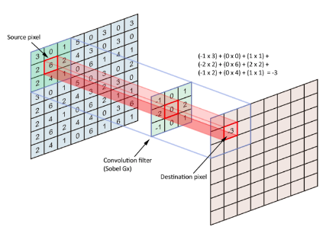
14.2 Convolutional Layer
Extract features of input data from CNN

Slide 5
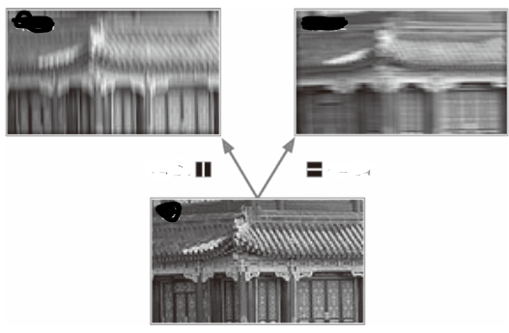
14.2 Convolutional Layer : Filter
Weight set
One Filter makes one Feature Map
Deep learning : Finding the value of a filter while learning

Slide 6
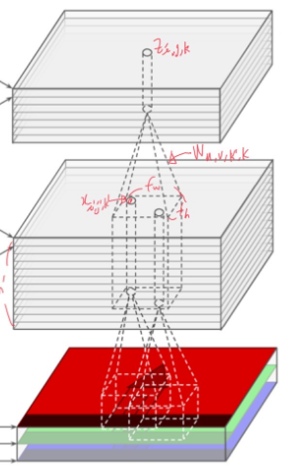
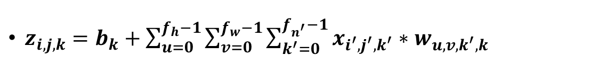
14.2 Convolutional Layer : Stack Feature Maps
$z_{i, j, k}=b_{k}+\sum_{u=0}^{f_{h}−1}{\sum_{v=0}^{f_{w}−1}{\sum_{k^{′}=0}^{f_{n^{′}}−1}{x_{i^{′}, j^{′}, k^{′}}∗w_{u, v, k^{′},k}}}}$

Slide 7
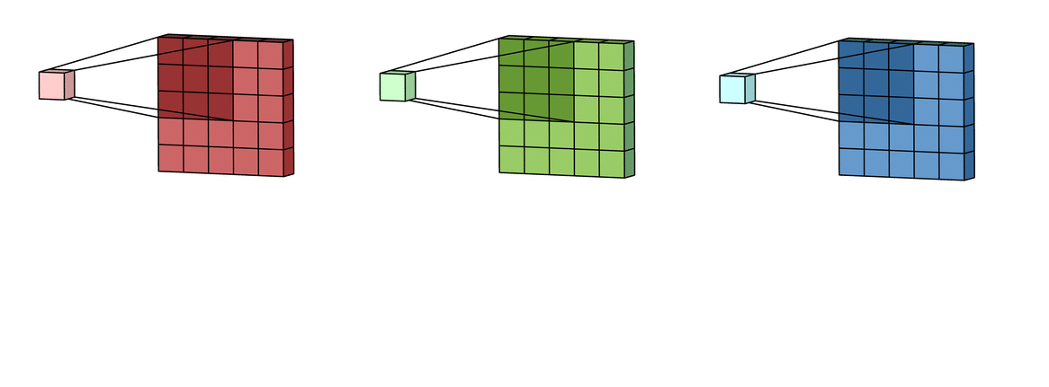
14.2 Convolutional Layer : Stack Feature Maps
Each kernel of the filter processes convolution operation

Slide 8
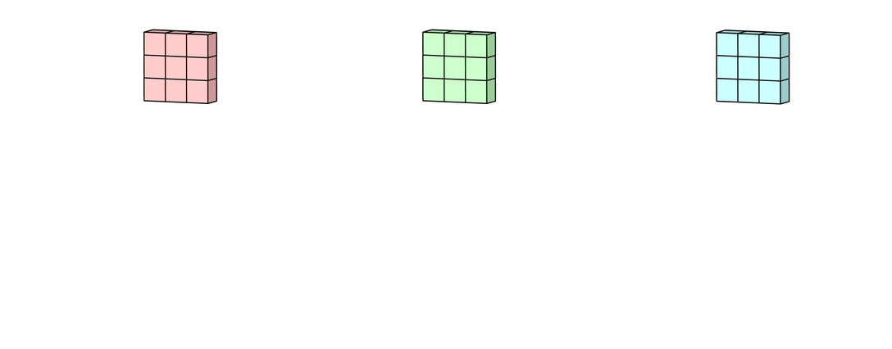
14.2 Convolutional Layer : Stack Feature Maps
Each feature maps are combined to form one channel

Slide 9
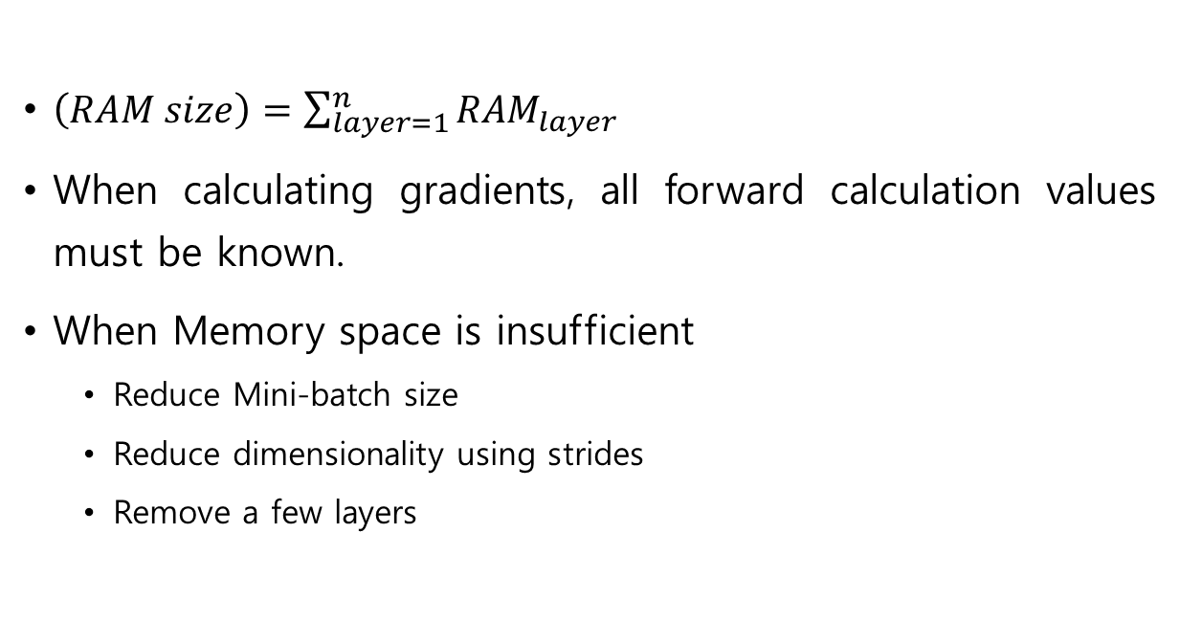
14.2 Convolutional Layer : Memory
$\left(RAM size\right)=\sum_{layer=1}^{n}{{RAM}_{layer}}$
When calculating gradients, all forward calculation values must be known.
When Memory space is insufficient
Reduce Mini-batch size
Reduce dimensionality using strides
Remove a few layers

Slide 10
14.3 Pooling Layer
Purpose : To reduce
Amount of computation
Memory usage
Number of Parameters

Slide 11

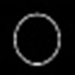
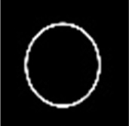
14.3 Pooling Layer : Max vs Avg
Original | Max pooling | Average pooling
- | Extract only big features | Extract average
- | Invariance | Equivariance

Slide 12
14.4 Pooling Layer Implementation with Keras
Depth-wise Pooling
Apply pooling only in channel direction
Reducing the number of channels while maintaining spatial information
Ex) 70*120*60 -> 70*120*20

Slide 13
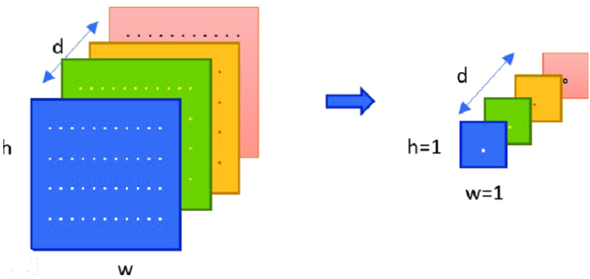
14.4 Pooling Layer Implementation with Keras
Global Average Pooling
Reducing dimensionality of 3D -> 1D
All values in each channel are averaged to represent each channel
Summarize information in feature map into a single value

Slide 14
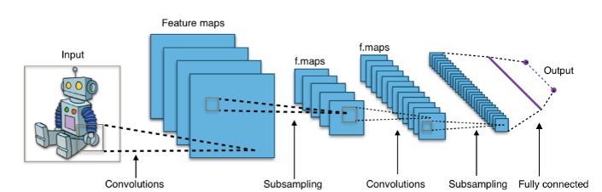
14.5 CNN Structure
The image gets smaller and smaller
But generally gets deeper because of convolutional layer
Making more Feature Maps

Slide 15
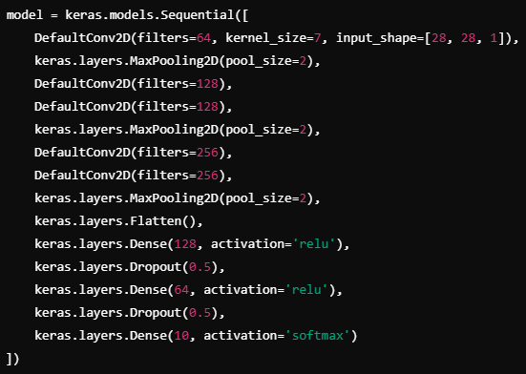
14.5 CNN Structure

Slide 16
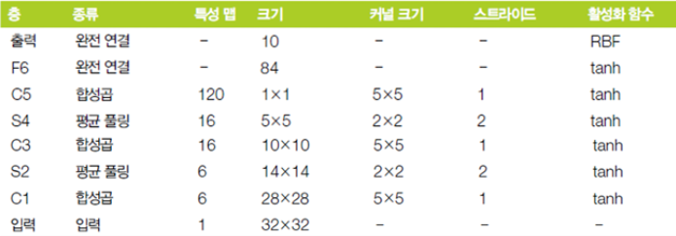
14.5 CNN Structure : LeNet-5
Key Features
Activation Function : tanh, RBF
Similar to Fashion MNIST Model

Slide 17
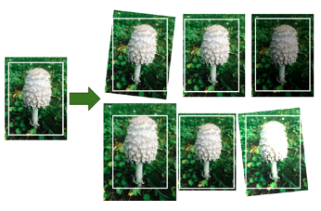
14.5 CNN Structure : AlexNet
Key Features
Max pooling, ReLU
Drop-out, Data augmentation
Implemented with GPU

Slide 18
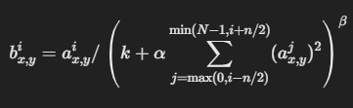
14.5 CNN Structure : AlexNet
Local Response Normalization(LRN)
Make the output of neurons more competitive
Implements “the Lateral Inhibitation”
Not used much today

Slide 19
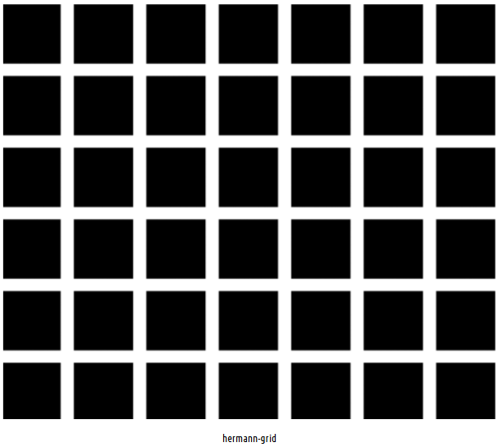
14.5 CNN Structure : AlexNet

Slide 20
14.5 CNN Structure : GoogLeNet
Inception Module
Motivation
Q: How to improve Neural Network performance?
A: Increasing Model’s size(#N of parameters)
Problems
Overfitting
Computation increases

Slide 21
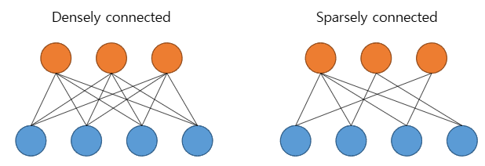
14.5 CNN Structure : GoogLeNet
Initial idea : Sparsely Connected Architecture
Connect only when the correlation between input nodes is high
“Cluster” is formed between nodes
Problems
Difficult to calculate on non-uniform, sparse data structures

Slide 22
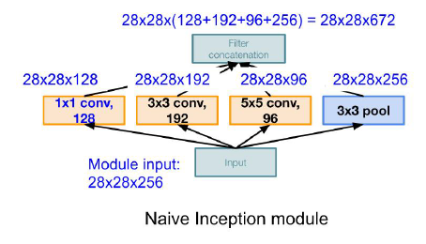
14.5 CNN Structure : GoogLeNet
Inception Module(Naive ver.)
1*1 filter : Extract highly correlated features within nearby areas
3*3, 5*5 filter : Extract clusters from more distantly correlated regions
Problems
Difficult to calculate on non-uniform, sparse data structures

Slide 23
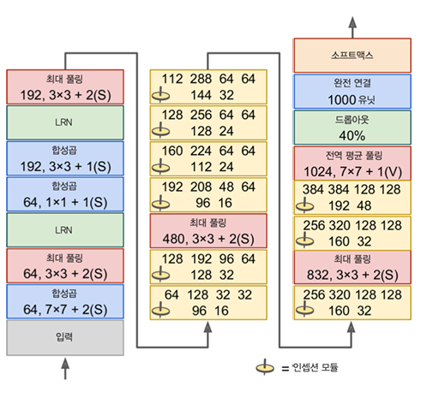
14.5 CNN Structure : GoogLeNet
Inception Module : Dimensionality reduction techniques
Using 1*1 Convolution : Compress each channel’s information
Dimension Reduction

Slide 24
14.5 CNN Structure : VGGNet
Key Features
Simple repetition of 2~3 convolutional layers + pooling layer
Filter size = 3*3
Three 3*3 = One 7*7
The deeper, the more nonlinear functions, and the better the decision function is learned.
Less parameters

Slide 25
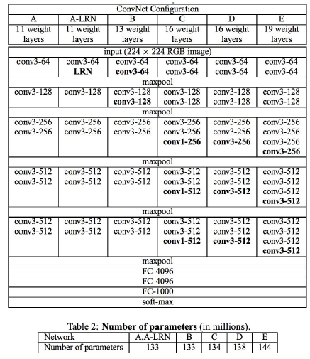
14.5 CNN Structure : VGGNet

Slide 26
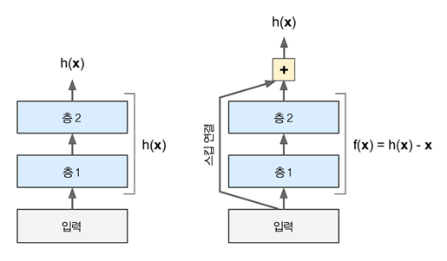
14.5 CNN Structure : ResNet
Key Features
Residual Network : Extremely Deep CNN
Skip connection

Slide 27
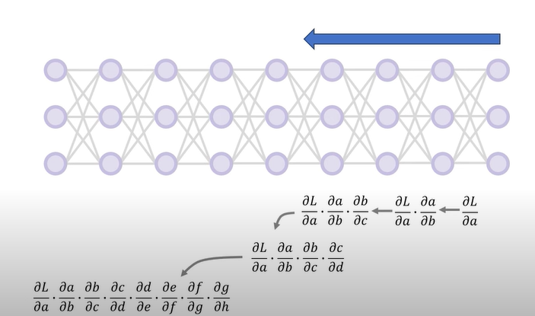
14.5 CNN Structure : ResNet
Skip Connection
Prevents “Vanishing Gradient”

Slide 28
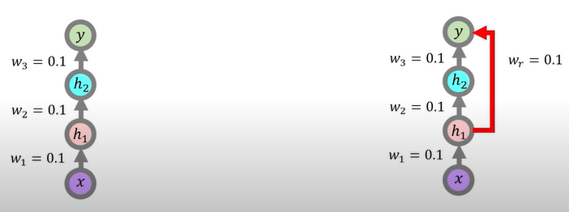
14.5 CNN Structure : ResNet
Example

Slide 29
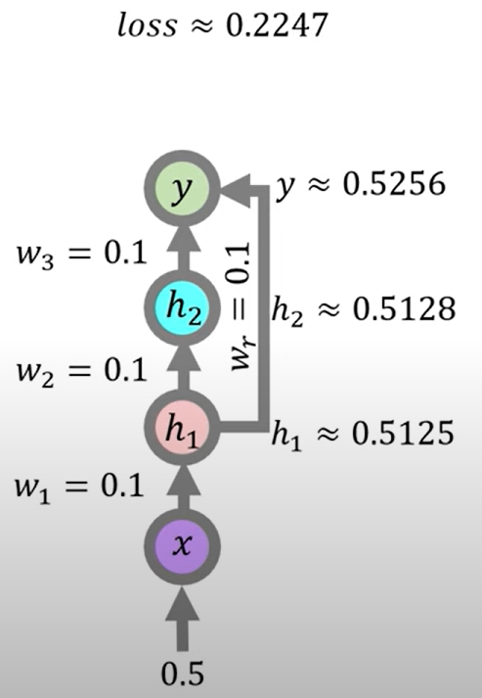
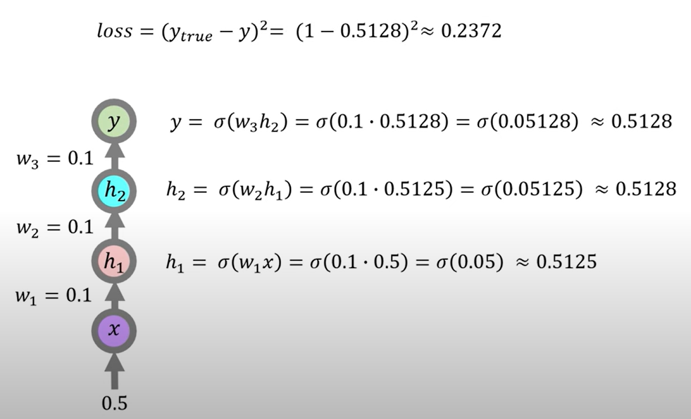
14.5 CNN Structure : ResNet
Example

Slide 30
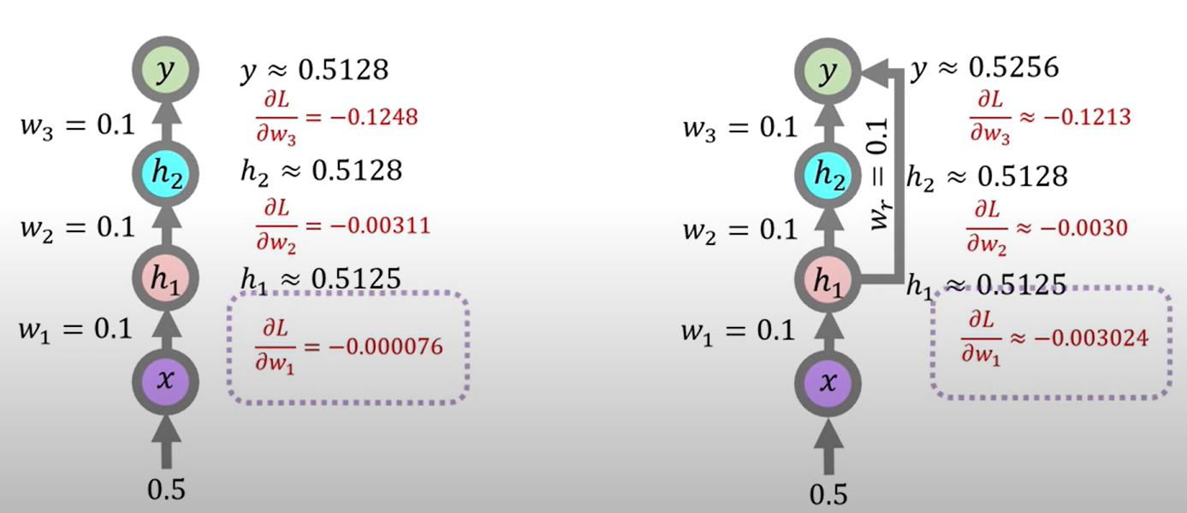
14.5 CNN Structure : ResNet
[Deep Learning 101] ResNet 잔차신경망이란? (feat.기울기소실문제)

